Slide 1
VR-Crosswalk
Communication between each component

Slide 2

Communication Overview
Host
Computer
Foottracking
Sensors right
I²C
Bluetooth (RS232)
4.Encoder
Horizontal
5.Encoder
Rotation
Bluetooth
Module
Foottracking
Sensors left
RS232
I²C
Arduino Uno
5xWIRE
5xWIRE
1.Encoder
Footplate left
SPI
CAN-Bus
Module
CAN
1.Motor Controller
2xWIRE
3xPWM
3xPWM
2.Encoder
Footplate right
2.Motor controller
Footplate left
3.Motor
Footplate left
2xWIRE
+PWM
2xPWM
2xWIRE
1.Motor
Horizontal
2.Motor
Rotation
3.Encoder
Rotation
3.Motor controller
Footplate right
4.Motor
Footplate right
2xWIRE
+PWM
2xPWM
2xWIRE

Slide 3
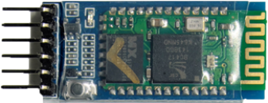
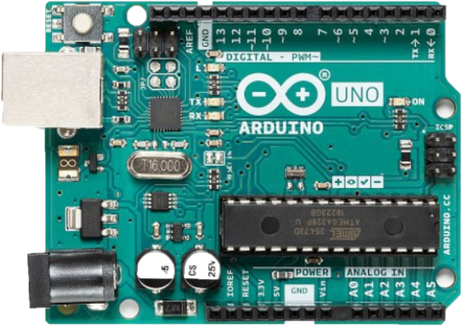
Arduino Uno – Bluetooth Module
For this wire, there might be a level shifter needed.
RS232
38400bps
Bluetooth
Module
Arduino Uno

Slide 4
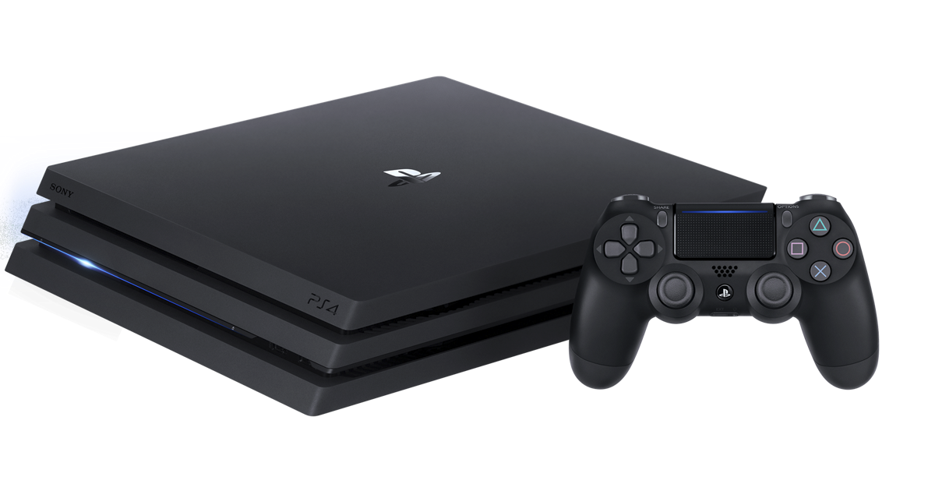
Bluetooth Module – Host Computer
Bluetooth
Module
Bluetooth (RS232)
Host
Computer

Slide 5
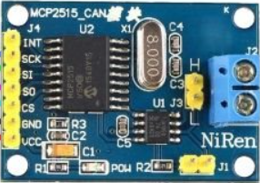
Arduino Uno – CAN-Bus Module
SPI
10mbps
CAN-Bus
Module
Arduino Uno

Slide 6
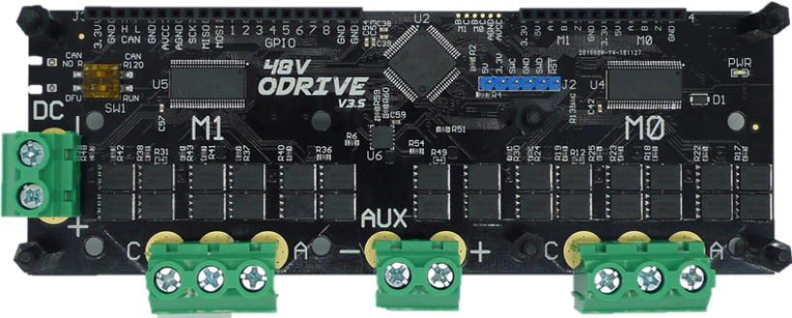
CAN-Bus Module – 1.Motor Controller
CAN
250kbps
CAN-Bus
Module
1.Motor Controller

Slide 7
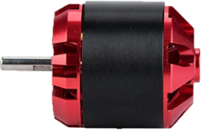
1.Motor Controller – 1.Motor Horizontal
1.Motor
Horizontal
1.Motor Controller
3xPWM

Slide 8
1.Motor Controller – 2.Motor Rotation
2.Motor
Rotation
1.Motor Controller
3xPWM

Slide 9
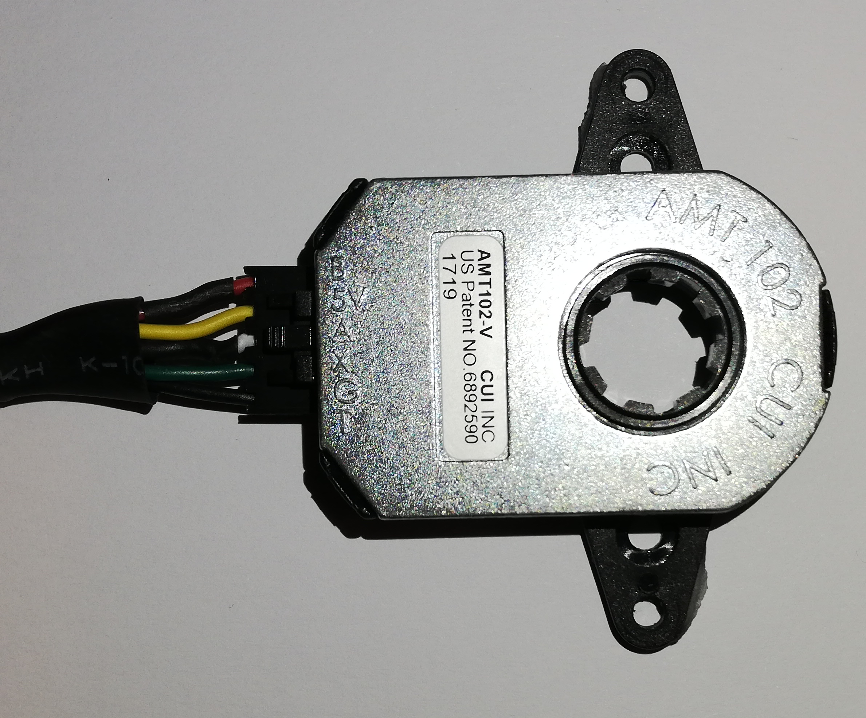
1.Motor Controller – 4.Encoder Horizontal
5xWIRE
4.Encoder
Horizontal
1.Motor Controller

Slide 10
1.Motor Controller – 5.Encoder Rotation
5xWIRE
5.Encoder
Rotation
1.Motor Controller

Slide 11
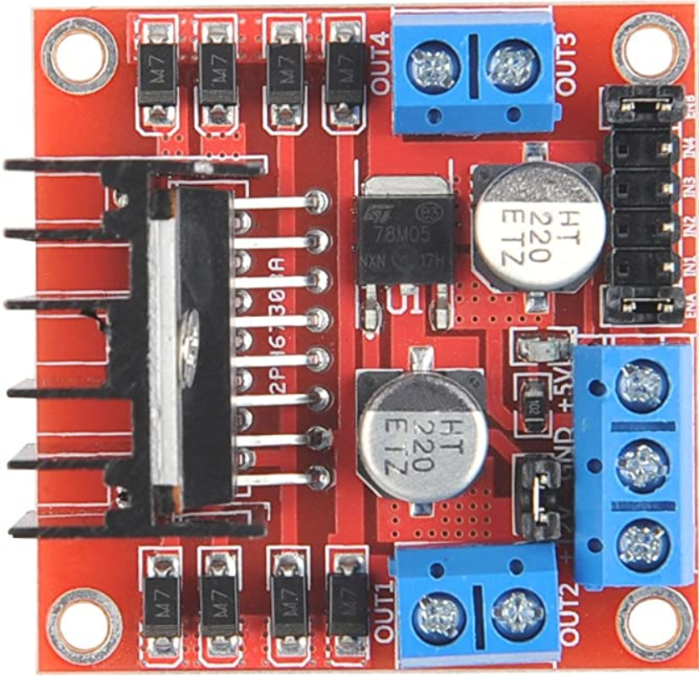
Arduino Uno – 2.Motor controller Footplate left
2xWIRE
PWM
2.Motor controller
Footplate left
Arduino Uno

Slide 12
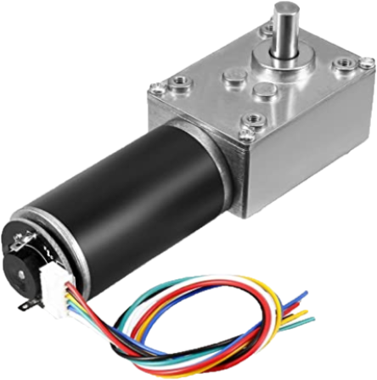
2.Motor controller Footplate left – 3.Motor Footplate left
3.Motor
Footplate left
2.Motor controller
Footplate left
2xPWM

Slide 13
Arduino Uno – 1.Encoder Footplate left
2xWIRE
Arduino Uno
1.Encoder
Footplate left

Slide 14
Arduino Uno – 3.Motor controller Footplate right
PWM
2xWIRE
3.Motor controller
Footplate right
Arduino Uno

Slide 15
3.Motor controller Footplate right – 4.Motor Footplate right
2xPWM
4.Motor
Footplate right
3.Motor controller
Footplate right

Slide 16
Arduino Uno – 2.Encoder Footplate right
2xWIRE
2.Encoder
Footplate right
Arduino Uno

Slide 17
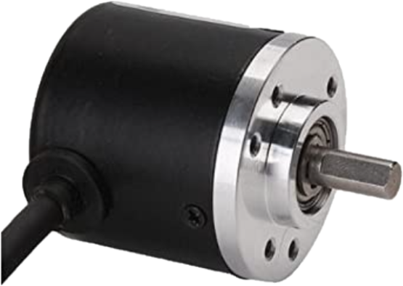
Arduino Uno – 3.Encoder Rotation
2xWIRE
3.Encoder
Rotation
Arduino Uno

Slide 18
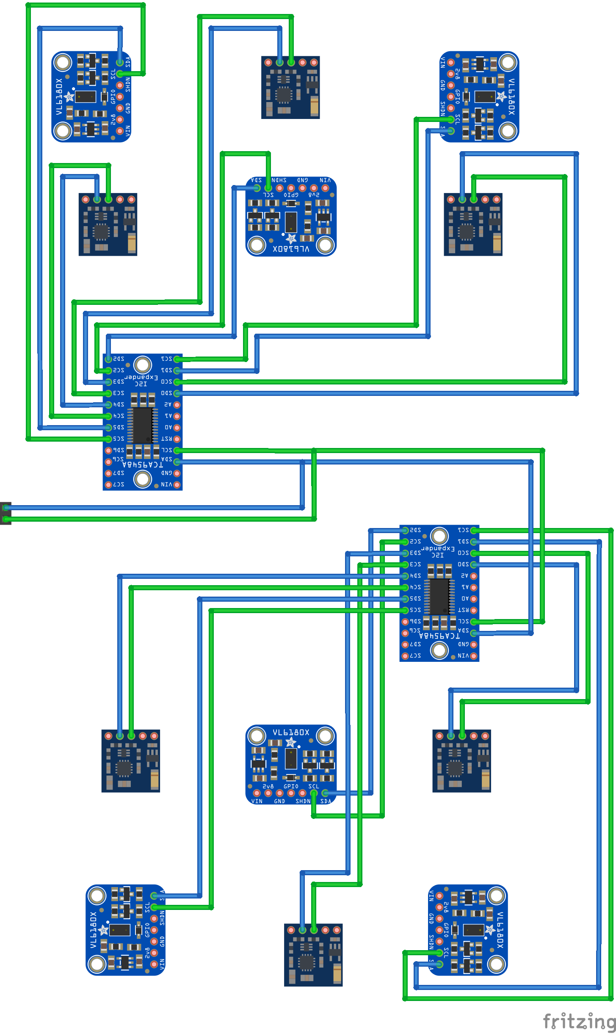
Arduino Uno – Foottracking Sensors left
Arduino Uno
Foottracking
Sensors left
I²C
400kbps

Slide 19
Arduino Uno – Foottracking Sensors right
Arduino Uno
Foottracking
Sensors right
I²C
400kbps

Slide 20
Arduino Uno – PIN Overview
--- CAN-Bus Module (SCK)
--- CAN-Bus Module (S0)
--- CAN-Bus Module (SI)
--- CAN-Bus Module (CS)
--- 2.Motor controller Footplate left (PWM/Enable)
--- 2.Motor controller Footplate left (EN1)
--- 2.Motor controller Footplate left (EN2)
--- 3.Motor controller Footplate right (PWM/Enable)
1.Encoder Footplate left (Channel A) ---
--- 2.Encoder Footplate right (Channel A)
1.Encoder Footplate left (Channel B) ---
--- 2.Encoder Footplate right (Channel B)
3.Motor controller Footplate right (EN1) ---
--- 3.Encoder Rotation (Channel A)
3.Motor controller Footplate right (EN2) ---
--- 3.Encoder Rotation (Channel B)
Foottracking Sensors (SDA) ---
--- Bluetooth Module (RX)
Foottracking Sensors (SCL) ---
--- Bluetooth Module (TX)

